Slide 1
Confidence intervals for proportions and means
Day 19

Slide 2
A new example, with less information:
Now I want to know about the average height of three year old apple trees. A random sample of 60 trees gave us a standard deviation of 2.8 inches (so we’ll assume $σ≈2.8 in)$.
Before we even reveal the sample data, what is the likelihood that the sample mean will be within 1.96 standard errors (SE) of the true population mean $μ$ for heights of apple trees?
Notes:
Stopped here in section 2

Slide 3
A new example, with less information:
Now I want to know about the average height of three year old apple trees. A random sample of 60 trees gave us a standard deviation of 2.8 inches (so we’ll assume $σ≈2.8 in)$.
1.96 standard errors = (1.96) ($2.8/\sqrt{60})$
= 1.96 (0.361) = 0.708 inches.
So before we even know our sample average, we know there is a 95% chance that it is within 1.96 SE of the population mean, i.e. within 0.708 inches of the population mean.

Slide 4
A new example, with less information:
Now let’s reveal the data average: It’s $\overline{x}=25.8 inches.$
BIG IDEA: Since there was a 95% chance that our sample average would be within 1.96 ∙ SE (0.708 inches) of the population average, this implies there is a 95% chance that the population average is within 1.96 ∙ SE (0.708 inches) of our sample mean.
(talk with your neighbor about why that’s a big idea)
Notes:
Left off here in section 1

Slide 5
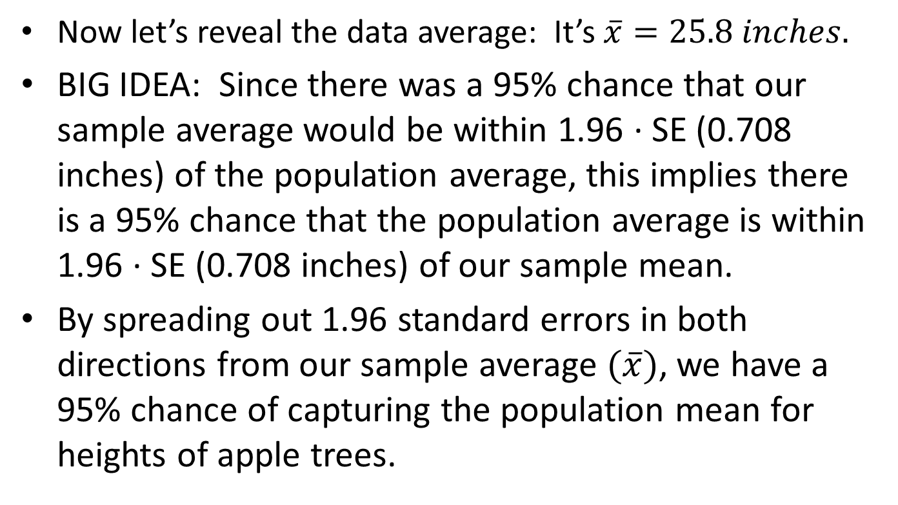
A new example, with less information:
Now let’s reveal the data average: It’s $\overline{x}=25.8 inches.$
BIG IDEA: Since there was a 95% chance that our sample average would be within 1.96 ∙ SE (0.708 inches) of the population average, this implies there is a 95% chance that the population average is within 1.96 ∙ SE (0.708 inches) of our sample mean.
By spreading out 1.96 standard errors in both directions from our sample average $(\overline{x})$, we have a 95% chance of capturing the population mean for heights of apple trees.

Slide 6
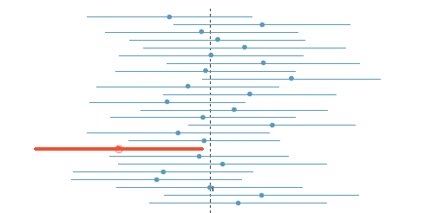
Famous image: 95% of confidence intervals of this type should capture the population mean $μ$. That means, just by chance, we expect 1 in 20 confidence intervals will fail to capture $μ$.

Slide 7
Interpreting confidence intervals
Suppose a recent study claimed that the average house price in Helena was between $242,000 and $264,000 with a confidence level of 95%.
What does that mean? Nearpod
Option 1: 95% of houses cost between $242,000 and $264,000
Option 2: There is a 95% chance that the average of all homes is between $242,000 and $264,000.
Suppose a recent study claimed, with 98% confidence, that the average amount of college debt per student is between $33,800 and $38,400.
What does that mean? Nearpod

Slide 8
Baby_Smoke data
Download the “Baby_Smoke.xlsx” data from the Moodle page. This data represents 1,000 cases of mothers and their newborns in North Carolina. The data set includes numeric data, such as age of mother, weight gained by mother, weight of newborns, and number of weeks of gestation (with 40 weeks being the usual benchmark of “full term”). The data set also includes categorical data, such as the gender of the newborn, the smoking habit of the mother, and the marital status of the mother. The first row of the data serves as a label.
Write 3 research questions you could attempt to answer using this data set. Ask at least one question involving proportions, but don’t limit yourself to only proportions.
Write your group’s questions on the board
Example Research Question: What proportion of new mothers in the data set are smokers, and can we use this to approximate the proportion of new mothers in NC that smoke? You may need the “=countif( )” command in Excel to answer some questions. Your instructor will show you how to use it.

Slide 9
Data definitions
fage father’s age in years.
mage mother’s age in years.
mature maturity status of mother.
weeks length of pregnancy in weeks.
premie whether the birth was classified as premature (premie) or full-term.
visits number of hospital visits during pregnancy.
marital whether mother is married or not married at birth.
gained weight gained by mother during pregnancy in pounds.
weight weight of the baby at birth in pounds.
lowbirthweight whether baby was classified as low birthweight (low) or not (not low).
gender gender of the baby, female or male.
habit status of the mother as a nonsmoker or a smoker.
whitemom whether mom is white or not white.

Slide 10
Sort the research questions
Which questions are statistically similar?

Slide 11
A sample question
Use the “=COUNTIF( )” command in Excel to find the number of babies that are born full term.
=COUNTIF(E2:E1001 , “=full term”)
Calculate the proportion of babies in the data set that are born full term.
The proportion that you just calculated is a point estimate for the actual proportion of full term babies in the whole population of NC. Why is a point estimate inappropriate for approximating the proportion? Can we do better?

Slide 12
A sample question
Use the “=COUNTIF( )” command in Excel to find the number of babies that are born full term.
=COUNTIF(E2:E1001 , “=full term”)
Calculate the proportion of babies in the data set that are born full term.
The proportion that you just calculated is a point estimate for the actual proportion of full term babies in the whole population of NC. Why is a point estimate inappropriate for approximating the proportion? Can we do better?
Watch out for missing data points, blank spots, or “NA”s.

Slide 13
Confidence Intervals for One Proportion
If we were to gather different samples of size 1,000 998 from the population of new mothers in NC we would most likely get different proportions of full term births every time.
From our experience with TinkerPlots simulations, we expect that the sampling distribution for random samples will be nearly normally distributed (this is called the Central Limit Theorem).
The mean of our sampling will be 0.848. We use the point estimate as the mean if we don’t have a different claim from a null hypothesis.
The standard error is given by: $SE=\sqrt{\frac{p\left(1−p\right)}{n}}$
To build the confidence interval: Lower Bound: $point estimate−zscore×SE$ Upper Bound: $point estimate+zscore×SE$

Slide 14
Now build the following confidence intervals
Create a 95% confidence interval for the proportion of full term births in NC.
Create a 99% confidence interval for the proportion of full term births in NC.
Answer some of the other research questions generated about proportions that require a confidence interval estimate.

Slide 15
Other potential questions
What portion of new births in NC were to women over 35?
What’s the average age of a mother in NC for a newborn baby?
What portion of women with newborns are single?

Slide 16
Exploring an example
What portion of new births in NC were to women over 35?
Clean up the data to find how many were over 35, how many were less than or equal to 35, and how many didn’t provide information (NA).
Sample proportion $\hat{p}=\frac{169}{829}=0.2039$ (point estimate)
Create a 95% confidence interval for the population proportion of newly delivered moms over 35.
Confidence interval is $\hat{p} ±1.96∙SE$
$0.204±1.96∙0.014$
0.190 to 0.218
We are 95% confidence that between 19.0 and 21.8% of newly delivered moms are over 35.

Slide 17
Exploring an example
What portion of new births in NC were to women over 35?
Clean up the data to find how many were over 35, how many were less than or equal to 35, and how many didn’t provide information (NA).
Sample proportion $\hat{p}=\frac{169}{829}=0.2039$ (point estimate)
Create a 95% confidence interval for the population proportion of newly delivered moms over 35.
Confidence interval is $\hat{p} ±1.96∙SE$
$0.204±1.96∙0.014$
0.190 to 0.218
We are 95% confidence that between 19.0 and 21.8% of newly delivered moms are over 35.

Slide 18
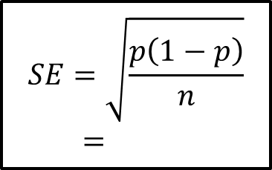
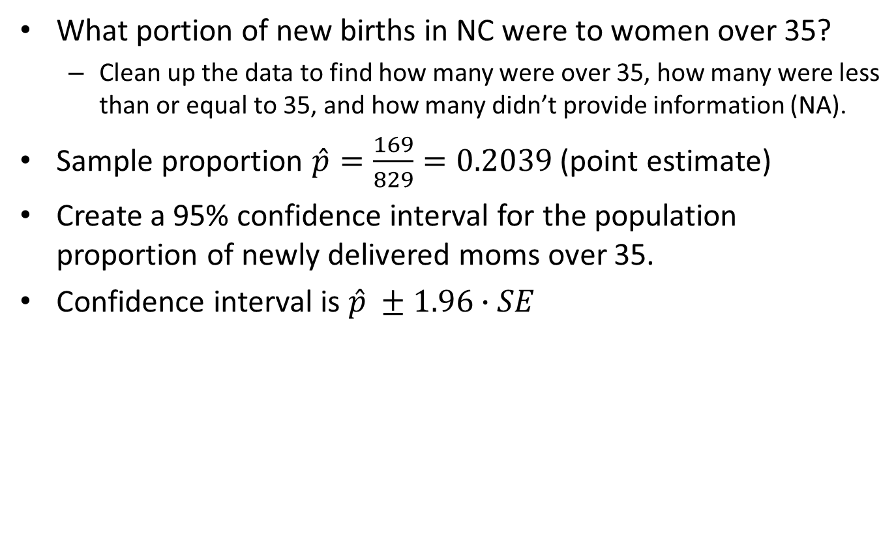
Exploring an example
What portion of new births in NC were to women over 35?
Clean up the data to find how many were over 35, how many were less than or equal to 35, and how many didn’t provide information (NA).
Sample proportion $\hat{p}=\frac{169}{829}=0.2039$ (point estimate)
Create a 95% confidence interval for the population proportion of newly delivered moms over 35.
Confidence interval is $\hat{p} ±1.96∙SE$
$0.204±1.96∙0.014$
0.190 to 0.218
We are 95% confidence that between 19.0 and 21.8% of newly delivered moms are over 35.
$$SE=\sqrt{\frac{p\left(1−p\right)}{n}}=0.014$$

Slide 19
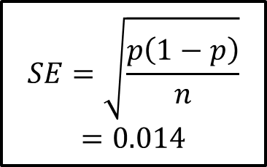
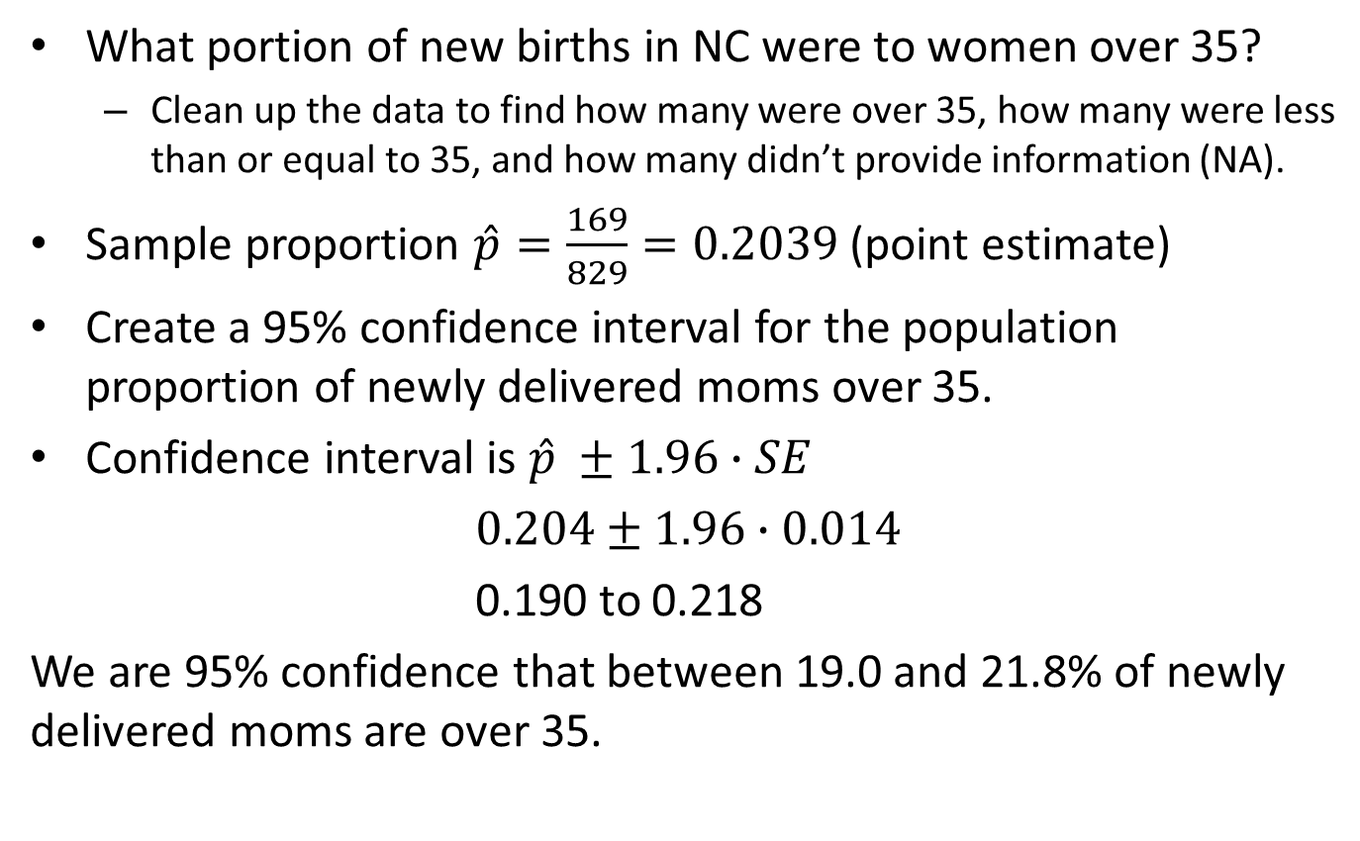
Exploring an example
What portion of new births in NC were to women over 35?
Clean up the data to find how many were over 35, how many were less than or equal to 35, and how many didn’t provide information (NA).
Sample proportion $\hat{p}=\frac{169}{829}=0.2039$ (point estimate)
Create a 95% confidence interval for the population proportion of newly delivered moms over 35.
Confidence interval is $\hat{p} ±1.96∙SE$
$0.204±1.96∙0.014$
0.190 to 0.218
We are 95% confidence that between 19.0 and 21.8% of newly delivered moms are over 35.
$$SE=\sqrt{\frac{p\left(1−p\right)}{n}}=0.014$$

